Slide 1
Human Computer Interaction
Dialog Notations and Design
Chapter 16a
Imran Siddiqi
imran.siddiqi@gmail.com

Slide 2

Dialog
Conversation between two or more parties
Dialog Notations and Design

Slide 3

Dialog
Conversation between two or more parties
Dialog Notations and Design

Slide 4
Dialog – User Interface Design
More specific meaning
Conversation between user and computer
Levels of computer language
  Lexical – Lowest level: Shape of icons, Text on message box
  Syntactic – Order of inputs and outputs
  Semantic – Meaning of conversation, Effect on internal application/data
In user Interfaces
  Dialog generally refers to the syntactic level of human–computer ‘conversation’
Dialog Notations and Design

Slide 5
Structured Human Dialog
Human-computer dialogue very constrained
Some human-human dialogue formal too …
Minister: do you man’s name take this woman …
Man: I do
Minister: do you woman’s name take this man …
Woman: I do
Man: With this ring I thee wed
Woman: With this ring I thee wed
Minister: I now pronounce you man and wife
Dialog Notations and Design

Slide 6
Lessons from Dialog
Wedding service
  Sort of script for three parties
  Participants must say certain things in a specifies order
  Some contributions are predetermined – “I do”
  Others variable – “do you man’s name …”
Dialog Notations and Design

Slide 7
Graphical Dialog Design Notations
State-transition nets (STN)
Petri nets, State charts
Flow charts, JSD diagrams
Dialog Notations and Design

Slide 8
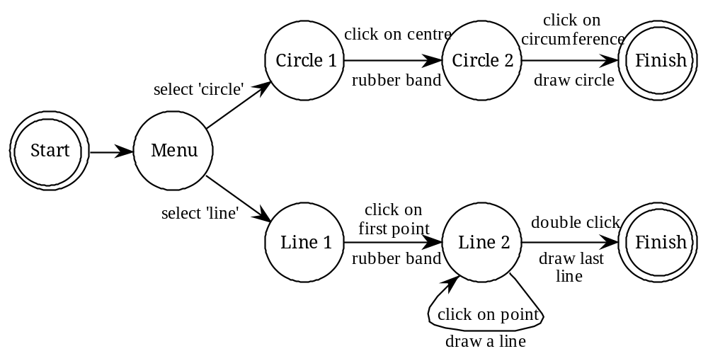
State Transition Networks (STN)
Circles – states
Arcs - actions/events
Dialog Notations and Design

Slide 9
State Transition Networks – Actions/Events
Arc labels a bit cramped because:
  The actions/events require most detail
Dialog Notations and Design

Slide 10
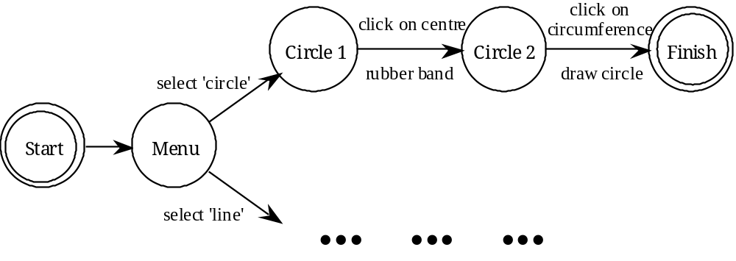
State Transition Networks - States
Labels in circles a bit uninformative:
  States are hard to name
  But easier to visualise
Dialog Notations and Design

Slide 11
Hierarchical STNs
Managing complex dialogues
Named sub-dialogues
Graphics Submenu
select ‘graphics’
Main
Menu
select ‘text’
Text Submenu
Paint Submenu
select ‘paint’
Dialog Notations and Design

Slide 12
Concurrent Dialogs
Simple Dialog Box
Text Style
bold
example
italic
underline
Dialog Notations and Design

Slide 13
Concurrent Dialogs
Three toggles - individual STNs
NO
bold
click on ‘bold’
bold
bold
NO
italic
click on ‘italic’
italic
italic
NO
u’line
click on ‘underline’
u’line
underline
Dialog Notations and Design

Slide 14
Concurrent Dialogs
Bold and Italic Combined
NO
style
click on ‘bold’
bold
only
Text Style
bold
example
italic
underline
click
on
‘italic’
click
on
‘italic’
italic
only
click on ‘bold’
bold
italic
Dialog Notations and Design

Slide 15
Concurrent Dialogs
All together - combinatorial explosion
Text Style
NO
style
‘bold’
bold
only
bold
example
italic
‘underline’
‘underline’
underline
‘italic’
‘italic’
u’line
only
‘bold’
bold
u’line
‘italic’
‘italic’
italic
only
‘bold’
bold
italic
‘underline’
‘underline’
italic
u’line
‘bold’
bold
italic
u’line
Dialog Notations and Design

Slide 16
Escapes
Escape/cancel keys
  End up with spaghetti of identical behaviors
Escape
Escape
Dialog Notations and Design

Slide 17
Escapes
Proposition
  On high level diagram ‘normal’ exit for each submenu
  Plus separate escape arc active ‘everywhere’ in submenu
Graphics Submenu
ESC
select ‘graphics’
normal
finish
Main
Menu
select ‘text’
Text Submenu
ESC
normal
finish
Paint Submenu
ESC
select ‘paint’
normal
finish
Dialog Notations and Design

Slide 18
Help Menus
Similar problems
  Nearly the same everywhere
  But return to same point in dialogue
  Could specify on STN … but very messy
Circle 1
click on centre
Circle 2
click on circumference
Finish
from
Menu
rubber band
draw circle
press HELP
button
press HELP
button
Help Subsystem
Help Subsystem
Dialog Notations and Design

Slide 19

References
Chapter 16 - Human Computer Interaction by Dix et al.
Interactive Tutorials on Petri Nets, Wil van der Aalst, et al. TU Eindhoven, Netherlands
Modeling and Simulation, P. Fishwick
Dialog Notations and Design

